Slide 1
Introduction

Slide 2
This Course
SE is unlike other CS topics
  OS , DBMS , Compilers etc talk about specific types of software product
  SW Engg. focuses on general software
Software Engineering is the systematic approach to development, operation, maintenance, and retirement of sw.
Basic Q. of SW Engg.: How to develop industrial-strength software?

Slide 3
What this course will give ?
Main objective: Give an idea of how industrial-strength software gets developed
At the end you should have the ability to plan, execute, and manage small software projects
Lectures will discuss how to perform different tasks in a project
In the project , the techniques will be applied
Lectures will be a phase ahead of the project

Slide 4
Project
A group project with 3-5 people
Will develop software for some customer to solve some real problems
Approximately 10 hours per week per student
Will start from 3rd week and last till the semester end
Extra lectures in start to kick-start the project

Slide 5
Evaluation and Grading
Project will have a weight of 50-60%
  a poor project cannot get a good grade
One mid sem exam and an end sem exam.
Project – group grade; marks equally divided unless the team specifies a diff distribution (based on contribution)
Review by a group of some other group’s work products

Slide 6
Software
Q : If you have to write a 10,000 line program in C to solve a problem, how long will it take?
Answers: generally range from 2-4 months
Let us analyze the productivity
  Productivity = output/input resources
  In SW output is considered as LOC
  Input resources is effort - person months; overhead cost modeled in rate for person month
  Though not perfect, some productivity measure is needed, as project has to keep it high

Slide 7
Software …
The productivity is 2.5-5 KLOC/PM
Q: What is the productivity in a typical commercial SW organization ?
A: Between 100 to 1000 LOC/PM
Q: Why is it low, when your productivity is so high? (people like you work in the industry)
A: What the student is building and what the industry builds are two different things

Slide 8
Software…
In a univ a student system is built while the commercial org builds industrial strength sw
What is the difference between a student program and industrial strength sw for the same problem?
Software (IEEE): collection of programs, procedures, rules, and associated documentation and data

Slide 9
Software…
Student
Developer is the user
  bugs are tolerable
  UI not important
  No documentation
Industrial Strength
Others are the users
  bugs not tolerated
  UI v. imp. issue
  Documents needed for the user as well as for the organization and the project

Slide 10
Software…
Student
SW not in critical use
Reliability, robustness not important
No investment
Don’t care about portability
Industrial Strength
Supports important functions / business
Reliability , robustness are very important
Heavy investment
Portability is a key issue here

Slide 11
Industrial strength software
Student programs for a problem & industrial strength software are two different things
Key difference is in quality (including usability, reliability, portability, etc.)
  High quality requires heavy testing, which consumes 30-50% of total development effort
  Requires development be broken in stages such that bugs can be detected in each
  Good UI, backup, fault-tolerance, following of stds etc increase the size for the same functionality

Slide 12
Industrial strength software
If 1/5th productivity, and increase in size by a factor of 2, industrial strength software will take 10 times effort
Brooks thumb-rule: Industrial strength sw costs 10 time more than student sw
Domain of SW Engg: Industrial strength sw
In SW Engg. and in this course, software means industrial strength software

Slide 13
Software is Expensive
Let us look at costs involved
  Productivity = 500 LOC/PM
  Cost to the company = $10K/PM
  Cost per LOC = $20
  I.e, each line of delivered code costs about $20.
A simple application for a business may have 20KLOC to 50KLOC
  Cost = $100K to $1Million
  Can easily run on $10K-$20K hardware
  So HW costs in an IT solution are small as compared to SW costs.

Slide 14
Software is Expensive…
The HW/SW ratio for a computer system has shown a reversal from the early years.
  In 50s , HW:SW :: 80:20
  In 80s , HW:SW :: 20:80
So , SW is very expensive
  Importance of optimizing HW is not much
  More important to optimize SW

Slide 15
Late & Unreliable
20-25% of SW projects never complete
  Because after some time they realize that the final cost will be much higher
Many companies report runaways
  budget & cost out of control
  consulting companies to help control them
One defence survey found that 70% of the equipment problems are due to SW
Many examples of software failures

Slide 16
Unreliable…
SW failures are different from failures of mechanical or electrical systems
In software, failures are not due to aging related problems
Failures occur due to bugs or errors that get introduced during development
I.e. the bug that causes a failure exists from start, only manifests later

Slide 17
Maintenance
Once sw delivered, it enters maintenance phase
Why is maintenance needed for sw when it does not wear with age?
  Residual errors requiring corrective maint
  Upgrades and environment changes – adaptive maint
Over sw life, maint can cost more than the development cost of sw

Slide 18
SE Challenges
Problem domain discussed before, now we discuss the area of SE
SE (IEEE): systematic approach to development,…., of software
Systematic approach: methodologies and practices that can be used to solve a problem from problem domain

Slide 19
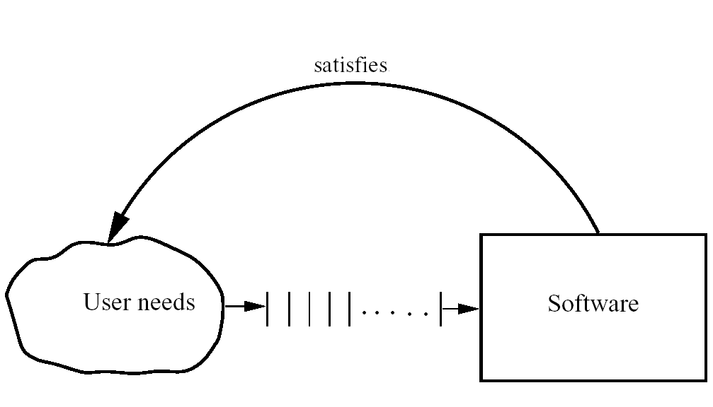
Basic Problem

Slide 20
SE Challenges
The problem of producing software to satisfy user needs drives the approaches used in SE
  Software is Industrial strength sw
But there are other factors that drive the selection of approaches
These factors include considerations of scale, quality, productivity, consistency, change, …

Slide 21
Scale
SE must deal with problem of scale
  methods for solving small problems do not scale up for large problems
  industrial strength SW problems tend to be large
SE methods must be scalable
Two clear dimensions in this
  engineering methods
  project management
For small, both can be informal or ad-hoc, for large both have to be formalized

Slide 22
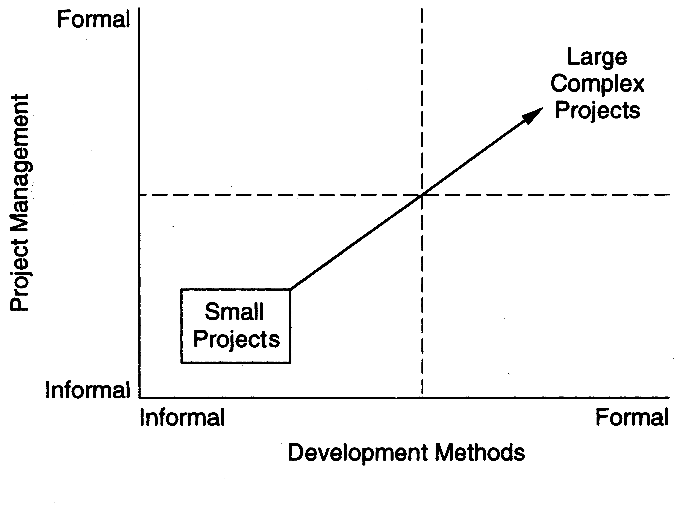
Scale…

Slide 23
Scale…
An illustration of issue of scale is counting the number of people in a room vs taking a census
  Both are counting problems
  Methods used in first not useful for census
  For large scale counting problem, must use different techniques and models
  Management will become critical

Slide 24
Scale: Examples
Gcc | 980KLOC | C, C++, yacc
Perl | 320 KLOC | C, perl, sh
Appache | 100 KLOC | C, sh
Linux | 30,000 KLOC | C, c++
Windows XP | 40,000 KLOC | C, C++

Slide 25
Productivity
An engg project driven by cost and schedule
In sw cost is mainly manpower cost, hence measured in person-months
Schedule is in months/weeks – very important in business context
Productivity capture both of these
  If P is higher, cost is lower
  If P is higher, time taken can be lesser
Approaches used by SE must deliver high P

Slide 26
Quality
Quality is the other major driving factor
Developing high Q sw is a basic goal
Quality of sw is harder to define
Approaches used should produce a high Q software

Slide 27
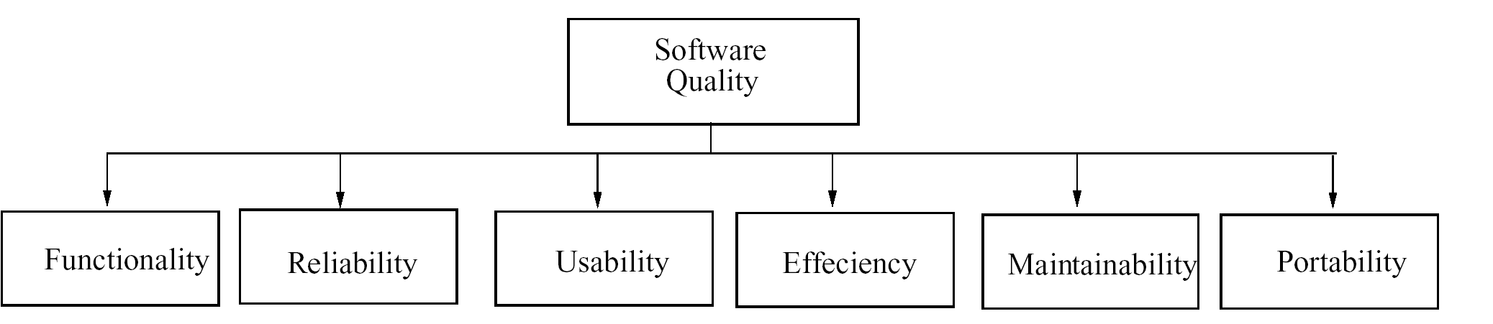
Quality – ISO standard

Slide 28
Quality – ISO std…
ISO std has six attributes
  Functionality
  Reliability
  Usability
  Efficiency
  Maintainability
  Portability

Slide 29
Quality…
Multiple dimensions mean that not easy to reduce Q to a single number
Concept of Q is project specific
  For some reliability is most important
  For others usability may be more important
Reliability is generally considered the main Q criterion

Slide 30
Quality…
Reliability = Probability of failure
  hard to measure
  approximated by no. of defects in software
To normalize Quality = Defect density
  Quality = No. of defects delivered / Size
Defects delivered - approximated with no. of defects found in operation
Current practices: less than 1 def/KLOC
What is a defect? Project specific!

Slide 31
Consistency and repeatability
Sometimes a group can deliver one good software system
Key SE challenge: how to ensure that success can be repeated
SE wants methods that can consistently produce high Q sw with high P
A sw org, wants to deliver high Q&P consistently across projects
Frameworks like ISO and CMM focus on this aspect a lot

Slide 32
Change
Only constant in business is change!
Software must change to support the changing business needs
SE practices must accommodate change
  Methods that disallow change, even if high Q and P, are of little use

Slide 33
SE Approach
We understand the problem domain, the factors that drive SE
  Consistently develop sw with high Q&P for large scale problems and under changes
Q&P are the basic objectives to be achieved under large scale and changes
Q&P governed by people, processes, and technology

Slide 34
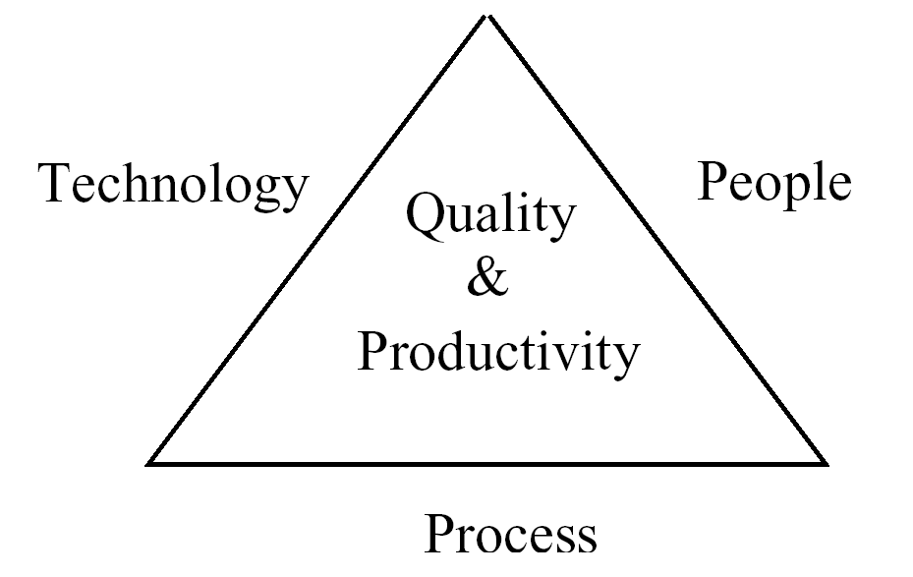
Iron Triangle

Slide 35
SE Approach
SE focuses mostly on processes for achieving the goals
Systematic approach is really about processes being used
SE separates process for developing sw from the developed product (i.e sw)
Premise: Process largely determines Q&P, hence suitable processes will lead to high Q&P

Slide 36
SE Approach…
Design of proper processes and their control is a key challenge SE faces
This focus on process makes SE different from many CS courses
Sw process is the equivalent of manufacturing process

Slide 37
SE Approach…
The development process used in SE is typically phased
Phases separate concerns with each phase focusing on some aspect
  Requirements, architecture, design, coding, testing are key phases
This phased process has to be properly managed to achieve the objectives
  Metrics and measurement important for this

Slide 38
Summary
The problem domain for SE is industrial strength software
Software comprises programs, documentation, and data
SE aims to provide methods for systematically developing SW
Main goal – achieve high quality and productivity (Q&P)

Slide 39
Summary…
Must have high Q&P with consistency, under large scale and changes
Basic approach of SE is to separate process from products and focus on process and managing the process

